Slide 1

Introduction to Network Layer:
Copyright © The McGraw-Hill Companies, Inc. Permission required for reproduction or display.

Slide 2
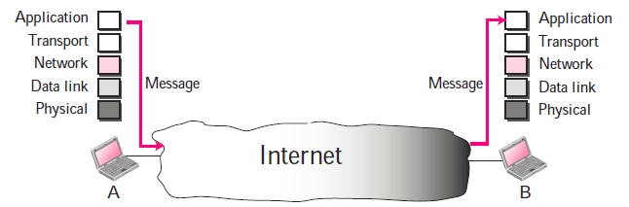
Introduction

Slide 3
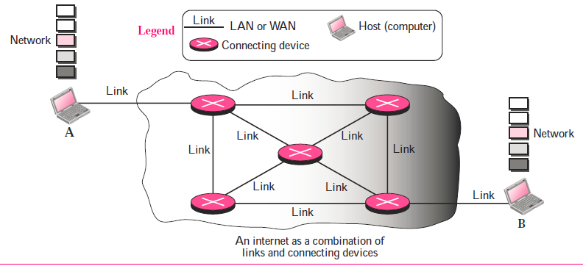
Contd..

Slide 4
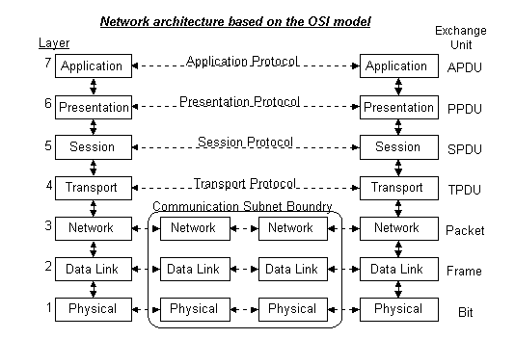
Contd..

Slide 5
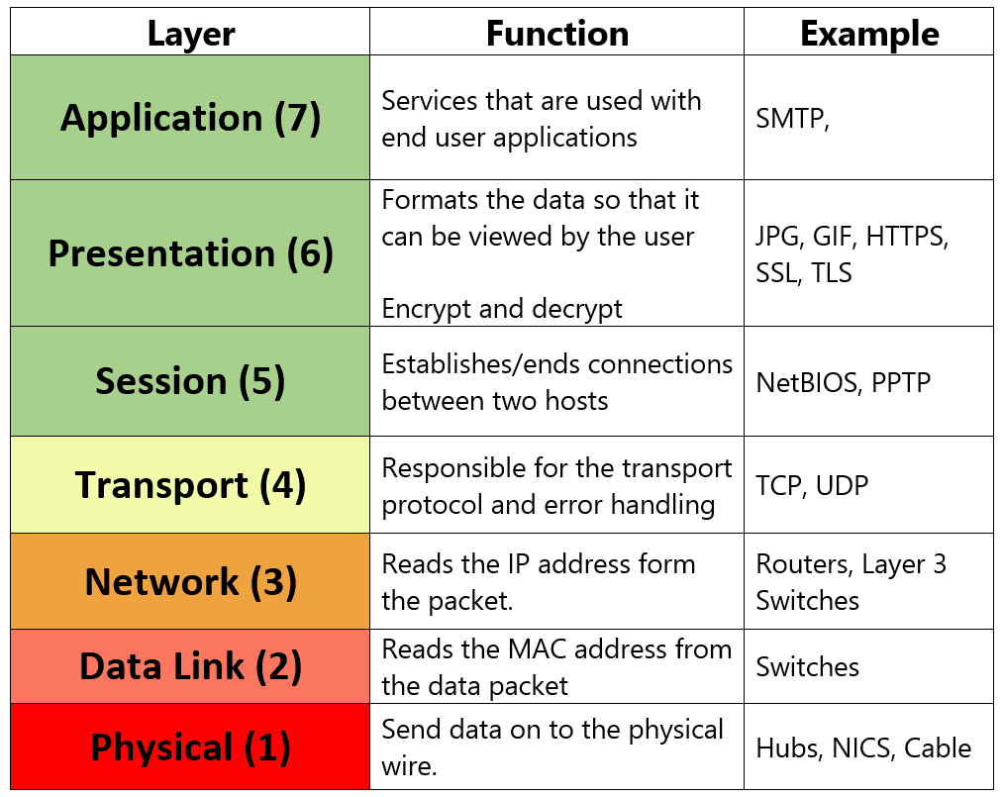
Contd..

Slide 6
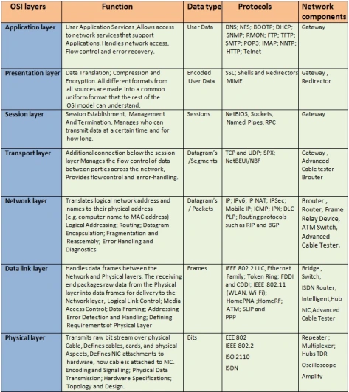
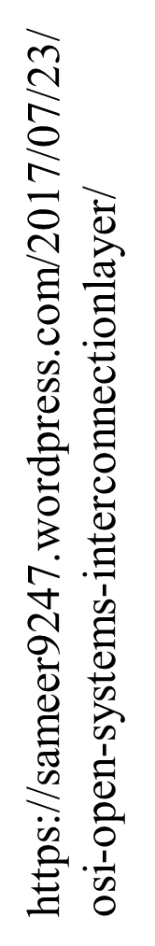

Slide 7
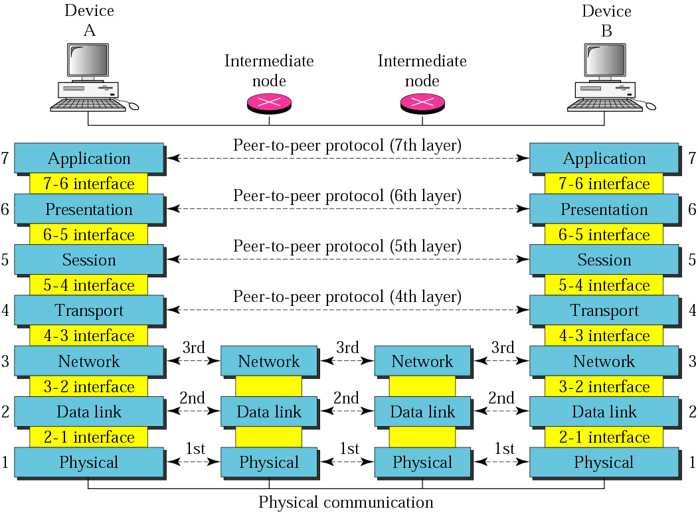
Contd..

Slide 8
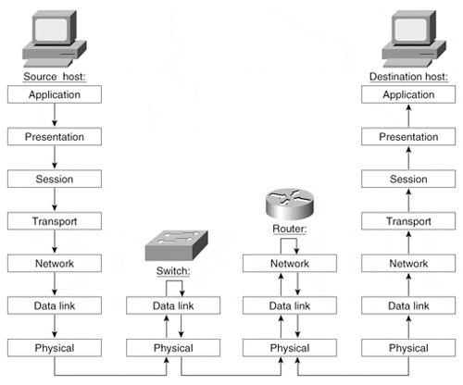
Contd..

Slide 9
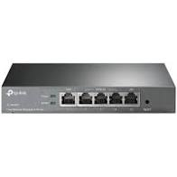
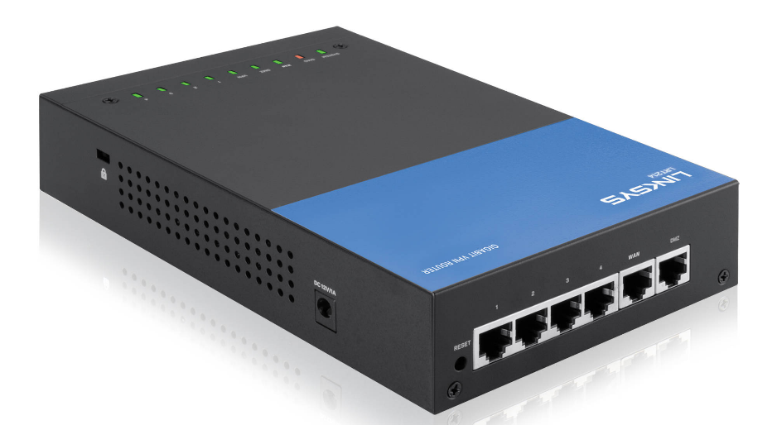
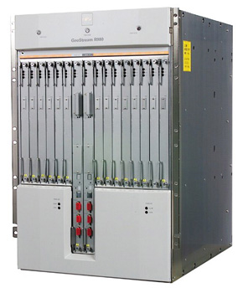
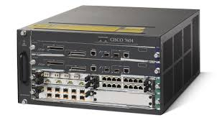
Contd.. Router

Slide 10

Switching
Figure 8.1 Switched network

Slide 11

Contd..
Figure 8.2 Taxonomy of switched networks

Slide 12
8-1 CIRCUIT-SWITCHED NETWORKS
A circuit-switched network consists of a set of switches connected by physical links.
A connection between two stations is a dedicated path made of one or more links.
However, each connection uses only one dedicated channel on each link.
Each link is normally divided into n channels by using FDM or TDM.
Topics discussed in this section:
Three Phases
Efficiency
Delay
Circuit-Switched Technology in Telephone Networks

Slide 13

Contd..
Figure 8.3 A trivial circuit-switched network

Slide 14
Contd..
Circuit switching takes place at the physical layer.
Before starting communication, the stations must make a reservation for the resources to be used during the communication. These resources, such as channels (bandwidth in FDM and time slots in TDM), switch buffers, switch processing time, and switch input/output ports, must remain dedicated during the entire duration of data transfer until the teardown phase.
Data transferred between the two stations are not packetized (physical layer transfer of the signal). The data are a continuous flow sent by the source station and received by the destination station, although there may be periods of silence.
There is no addressing involved during data transfer. The switches route the data based on their occupied band (FDM) or time slot (TDM). Of course, there is end-to-end addressing used during the setup phase, as we will see shortly.

Slide 15

Note
In circuit switching, the resources need to be reserved during the setup phase;
The resources remain dedicated for the entire duration of data transfer until the teardown phase.

Slide 16
Example 8.1
As a trivial example, let us use a circuit-switched network to connect eight telephones in a small area. Communication is through 4-kHz voice channels.
We assume that each link uses FDM to connect a maximum of two voice channels. The bandwidth of each link is then 8 kHz.
Figure 8.4 shows the situation. Telephone 1 is connected to telephone 7; 2 to 5; 3 to 8; and 4 to 6.
Of course the situation may change when new connections are made. The switch controls the connections.

Slide 17

Contd..
Figure 8.4 Circuit-switched network used in Example 8.1

Slide 18
Example 8.2
As another example, consider a circuit-switched network that connects computers in two remote offices of a private company.
The offices are connected using a T-1 line leased from a communication service provider.
There are two 4 × 8 (4 inputs and 8 outputs) switches in this network.
For each switch, four output ports are folded into the input ports to allow communication between computers in the same office.
Four other output ports allow communication between the two offices. Figure 8.5 shows the situation.

Slide 19

Contd..
Figure 8.5 Circuit-switched network used in Example 8.2

Slide 20

Contd..
Figure 8.6 Delay in a circuit-switched network

Slide 21
Total Delay for Circuit Switched Network
Transmission Delay: T & Propagation Delay: P
Setup time, ST= Req Pkt +Ack Pkt
Setup time, ST= T_{s}+P_{s}+ T_{D}+P_{D.}
Data Transfer, DT= T_{data}+ P_{data.}
Disconnect Time, DCT= T_{D}+P_{D.}
Total Delay=ST+DT+ DCT
Note : ignoring processing time in each switch

Slide 22
Contd..
4 hops (point-to-point links) between two terminals nodes; Transmission rate 9600 bps on all links; 24 overhead bits [Header + Trailer] for each packet; 1ms per-hop signal propagation delay. 1 sec. Call set-up time for circuit switched connection across 4 hops.
(a) Message size 5000 bits, packet size 1024 bits, all other parameters the same.
Circuit switching 5000 bits at 9600 bps ⇒ 0.521 sec.
Message duration total propagation delay 0.004 sec.
Total time for message is 0.521 + 0.004 + 1 = 1.525 sec

Slide 23
Problem
A path in a digital circuit-switched network has a data rate of 1 Mbps. The exchange of 1000 bits is required for the setup and teardown phases. The distance between two parties is 5000 km. Answer the following questions if the propagation speed is 2 X 10⁸ m:
What is the total delay if 1000 bits of data are exchanged during the data transfer phase?
What is the total delay if 100,000 bits of data are exchanged during the data transfer phase?
What is the total delay if 1,000,000 bits of data are exchanged during the data transfer phase?
Find the delay per 1000 bits of data for each of the above cases and compare them. What can you infer?

Slide 24
Note
Switching at the physical layer in the traditional telephone network uses
the circuit-switching approach.

Slide 25
Blocking or Non-blocking
Blocking
  A blocking network is unable to connect end- points because the critical paths are in use and there are no alternative paths
  Used on voice systems
    Short duration calls
Non-blocking
  Permits all stations to connect (in pairs) at once
  Used for some data connections

Slide 26
Circuit-Switched Routing
Many connections will need paths through more than one switch
Need to find a route
  Efficiency
  Resilience
Public telephone switches are a tree structure
  Static routing uses the same approach all the time
Dynamic routing allows for changes in routing depending on traffic
  Uses a peer structure for nodes

Slide 27
Alternate Routing
Possible routes between end offices predefined
Originating switch selects appropriate route
Routes listed in preference order
Different sets of routes may be used at different times

Slide 28
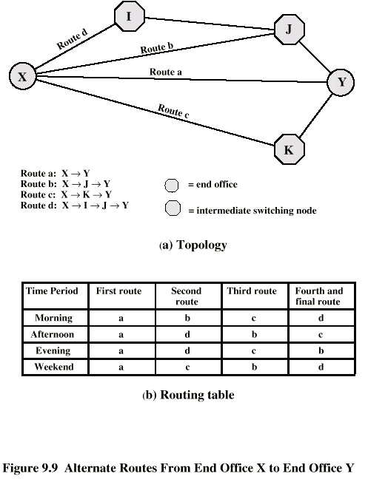
Alternate Routing Diagram

Slide 29
Control Signaling Functions
Audible communication with subscriber
Transmission of dialed number
Call can not be completed indication
Call ended indication
Signal to ring phone
Billing info
Equipment and trunk status info
Diagnostic info
Control of specialist equipment

Slide 30
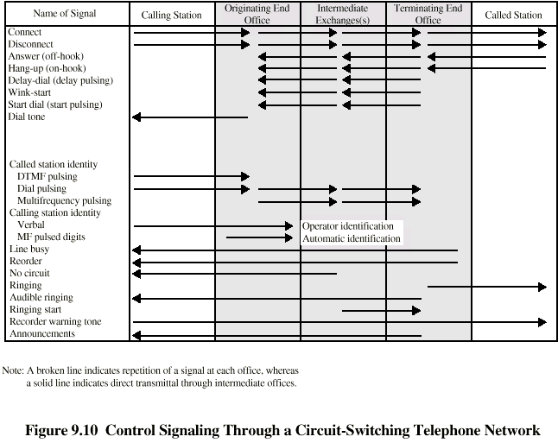
Control Signals

Slide 31
Location of Signaling
Subscriber to network
  Depends on subscriber device and switch
Within network
  Management of subscriber calls and network
  More complex

Slide 32
In-Channel Signaling
Use same channel for signaling and call
  Requires no additional transmission facilities
Inband
  Uses same frequencies as voice signal
  Can go anywhere a voice signal can
  Impossible to set up a call on a faulty speech path
Out-of-band
  Voice signals do not use full 4kHz bandwidth
  Narrow signal band within 4kHz used for control
  Can be sent whether or not voice signals are present
  Need extra electronics
  Slower signal rate (narrow bandwidth)

Slide 33
Drawbacks of In-Channel Signaling
Limited transfer rate
Delay between entering address (dialing) and connection
Overcome by use of common channel signaling

Slide 34
Common Channel Signaling
Control signals carried over paths independent of voice channel
One control signal channel can carry signals for a number of subscriber channels
Common control channel for these subscriber lines
Associated Mode
  Common channel closely tracks interswitch trunks
Disassociated Mode
  Additional nodes (signal transfer points)
  Effectively two separate networks

Slide 35
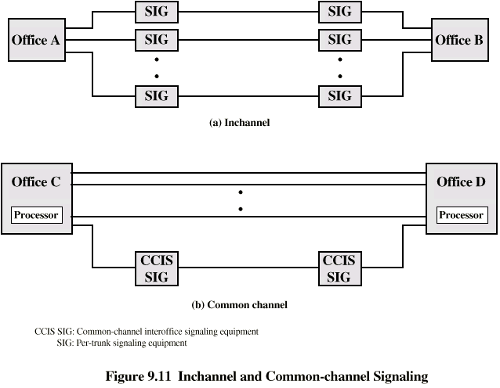
Common vs. In-Channel Signaling

Slide 36
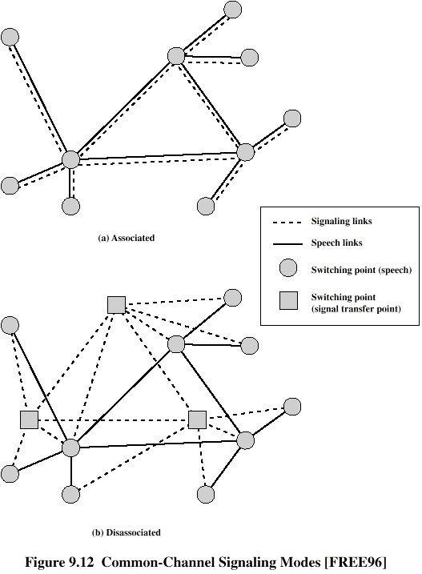
Signaling Modes

Slide 37
Signaling System Number 7
SS7
Most widely used common channel signaling scheme
Internationally standardized and general purpose
SS7 network and protocol used for:
  Basic call setup, management, tear down
  Wireless services such as PCS, roaming, authentication
  Toll free and toll (900) wireline services
  Enhanced features such as call forwarding, caller ID, 3-way calling
  Efficient and secure worldwide telecommunications

Slide 38
8-2 DATAGRAM NETWORKS
In data communications, we need to send messages from one end system to another. If the message is going to pass through a packet-switched network, it needs to be divided into packets of fixed or variable size. The size of the packet is determined by the network and the governing protocol.
Topics discussed in this section:
Routing Table
Efficiency
Delay
Datagram Networks in the Internet

Slide 39
Two Basic Forms of Packet Switching
Packets handled in two ways
  Datagram (covered in this section)
  Virtual circuit (covered in the next section)

Slide 40
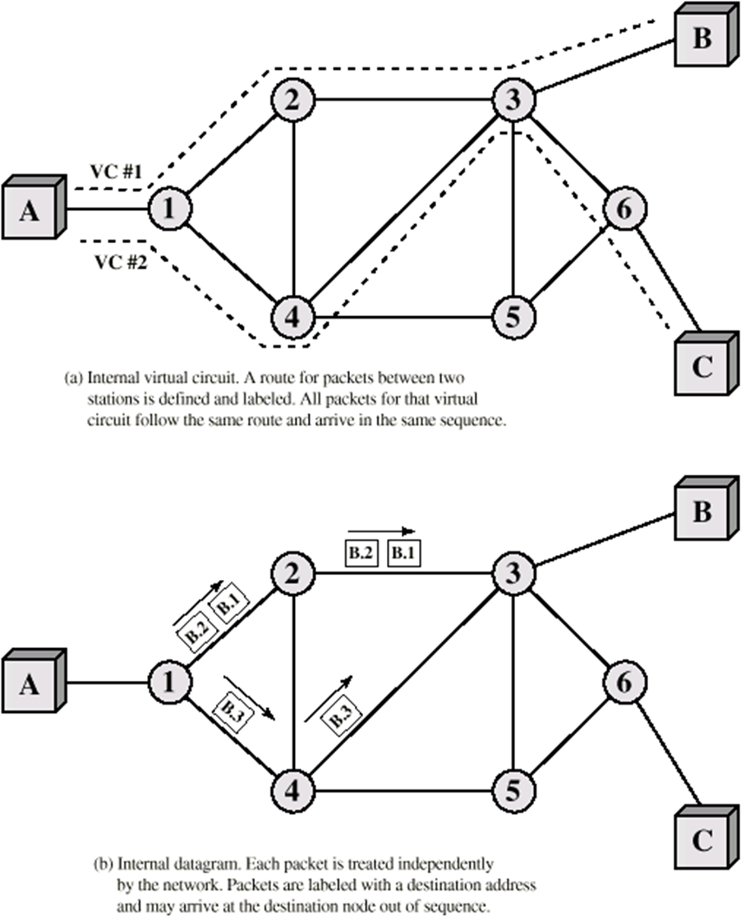
Datagram
Each packet treated independently
Packets can take any practical route
Packets may arrive out of order
Packets may get lost or delayed
Up to receiver to re-order packets and recover from missing packets

Slide 41
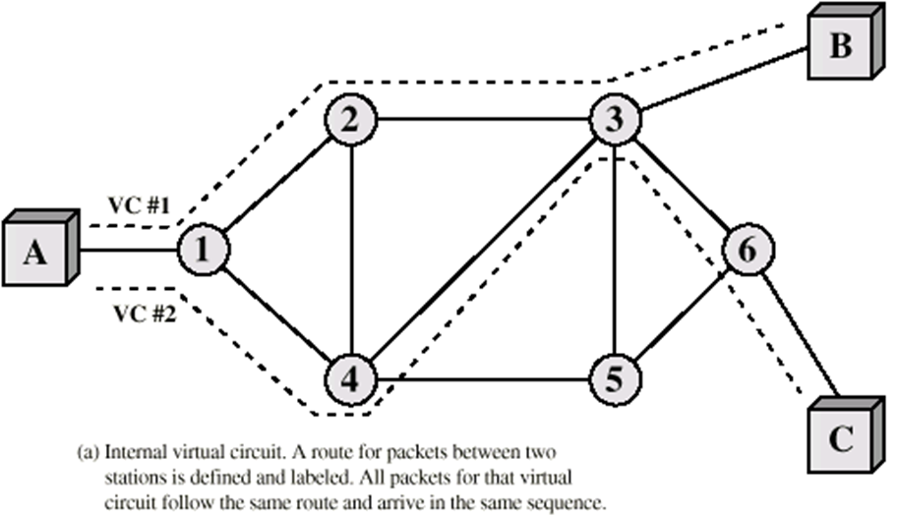
Virtual Circuit
Preplanned route established before any packets sent
Call request and call accept packets establish connection (handshake)
Each packet contains a virtual circuit identifier instead of destination address
No routing decisions required for each packet
Clear request to drop circuit
Not a dedicated

Slide 42

Contd..
Figure 8.7 A datagram network with four switches (routers)

Slide 43

Contd..
Figure 8.8 Routing table in a datagram network

Slide 44
Note
A switch in a datagram network uses a routing table that is based on the destination address.

Slide 45
Note
The destination address in the header of a packet in a datagram network
remains the same during the entire journey of the packet.

Slide 46

Contd..
Figure 8.9 Delay in a datagram network
There are three transmission times (3T), three propagation delays (slopes 3't of the lines), and two waiting times (WI + w2)' We ignore the processing time in each switch.Total delay =3T + 3t + WI + W2

Slide 47
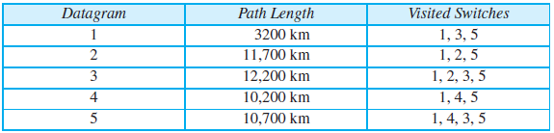
Question
Five equal-size datagrams belonging to the same message leave for the destination one after another. However, they travel through different paths as shown in the table.
We assume that the delay for each switch (including waiting and processing) is 3, 10, 20, 7, and 20 ms respectively. Assuming that the propagation speed is 2 × 10⁸ m/s, find the order the datagrams arrive at the destination and the delay for each. Ignore any other delays in transmission.

Slide 48
Note
Switching in the Internet is done by using the datagram approach
to packet switching at
the network layer.

Slide 49
8-3 VIRTUAL-CIRCUIT NETWORKS
A virtual-circuit network is a cross between a circuit-switched network and a datagram network. It has some characteristics of both.
Topics discussed in this section:
Addressing
Three Phases
Efficiency
Delay
Circuit-Switched Technology in WANs

Slide 50
Contd..
A virtual-circuit network is a cross between a circuit-switched network and a datagram network. It has some characteristics of both.
As in a circuit-switched network, there are setup and teardown phases in addition to the data transfer phase.
Resources can be allocated during the setup phase, as in a circuit-switched network, or on demand, as in a datagram network.
As in a datagram network, data are packetized and each packet carries an address in the header. However, the address in the header has local jurisdiction (it defines what should be the next switch and the channel on which the packet is being canied), not end-to-end jurisdiction. The reader may ask how the intermediate switches know where to send the packet if there is no final destination address carried by a packet. The answer will be clear when we discuss virtual-circuit identifiers in the next section.

Slide 51
Contd..
As in a circuit-switched network, all packets follow the same path established during the connection.
A virtual-circuit network is normally implemented in the data link layer, while a circuit-switched network is implemented in the physical layer and a datagram network in the network layer. But this may change in the future.

Slide 52

Contd..
Figure 8.10 Virtual-circuit network

Slide 53

Contd..
Figure 8.11 Virtual-circuit identifier

Slide 54

Contd..
Figure 8.12 Switch and tables in a virtual-circuit network

Slide 55

Contd..
Figure 8.13 Source-to-destination data transfer in a virtual-circuit network

Slide 56

Contd..
Figure 8.14 Setup request in a virtual-circuit network

Slide 57

Contd..
Figure 8.15 Setup acknowledgment in a virtual-circuit network

Slide 58
Note
In virtual-circuit switching, all packets belonging to the same source and
destination travel the same path;
but the packets may arrive at the destination with different delays
if resource allocation is on demand.

Slide 59

Contd..
Figure 8.16 Delay in a virtual-circuit network
Total delay = 3T+ 3't + setup delay + teardown delay

Slide 60
Note
Switching at the data link layer in a switched WAN is normally
implemented by using
virtual-circuit techniques.

Slide 61
Switched VC vs Permanent VC setup
A virtual circuit can be either switched or permanent.
If permanent, an outgoing VCI is given to the source, and an incoming VCI is given to the destination.
The source always uses this VCI to send frames to this particular destination.
The destination knows that the frame is coming from that particular source if the frame carries the corresponding incoming VCI.
If a duplex connection is needed, two virtual circuits are established.

Slide 62
Contd..
A PVC has several drawbacks:
  Always connected, so always paying
  Connection is between two parties only.
If you need a connection to another point, you need another PVC.
Don’t like these disadvantages? Use an SVC.

Slide 63
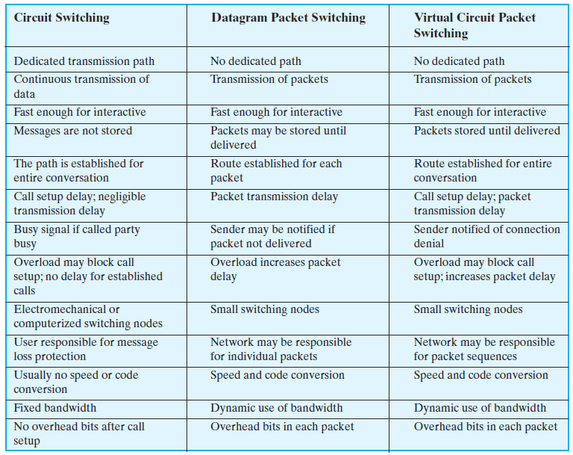

Slide 64
8-4 STRUCTURE OF A SWITCH
We use switches in circuit-switched and packet-switched networks. In this section, we discuss the structures of the switches used in each type of network.
Topics discussed in this section:
Structure of Circuit Switches
Structure of Packet Switches

Slide 65
Structure of Circuit Switches
Circuit Switching uses either of two technologies
  Space-Division Switch
  Time-Division Switch
Notes:
Space-Division Switch: paths in the circuit are separated from each other spatially.

Slide 66
Space-Division Switch
Single transmission path is accomplished in a switch by using a physically separate set of crosspoints.
  Crossbar Switch
  Multistage Switch

Slide 67

Contd..
Crossbar switch
Figure 8.17 Crossbar switch with three inputs and four outputs

Slide 68


Contd..
Multistage switch
-
Figure 8.18 Multistage switch

Slide 69
Problem
Design a three-stage, 200 x 200 switch (N =200) with k =4 and n =20.
Solution
In the first stage we have N/n or 10 crossbars, each of size 20 x 4.
In the second stage, we have 4 crossbars, each of size 10 x 10. In
The third stage, we have 10 crossbars, each of size 4 x 20.
The total number of crosspoints is 2kN + k(N/n)2, or 2000 crosspoints.
This is 5 percent of the number of crosspoints in a single-stage switch (200 x 200 = 40,000).

Slide 70
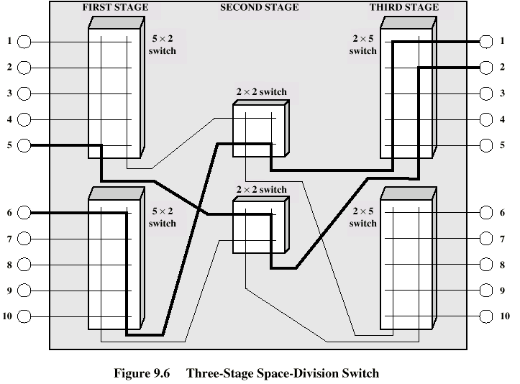
Three Stage Switch

Slide 71

Contd..
Figure 8.19 Time-slot interchange

Slide 72

Contd..
Figure 8.20 Time-space-time switch

Slide 73

Structure of Packet Switches
Figure 8.21 Packet switch components

Slide 74

Contd..
Figure 8.22 Input port

Slide 75

Contd..
Figure 8.23 Output port

Slide 76

Contd..
Figure 8.24 A banyan switch

Slide 77

Contd..
Figure 8.25 Examples of routing in a banyan switch

Slide 78
4-4 NETWORK LAYER SERVICES
In this section, we briefly discuss services provided by the network layer.
Our discussion is mostly based on the connectionless service, the dominant service in today’s Internet.

Slide 79
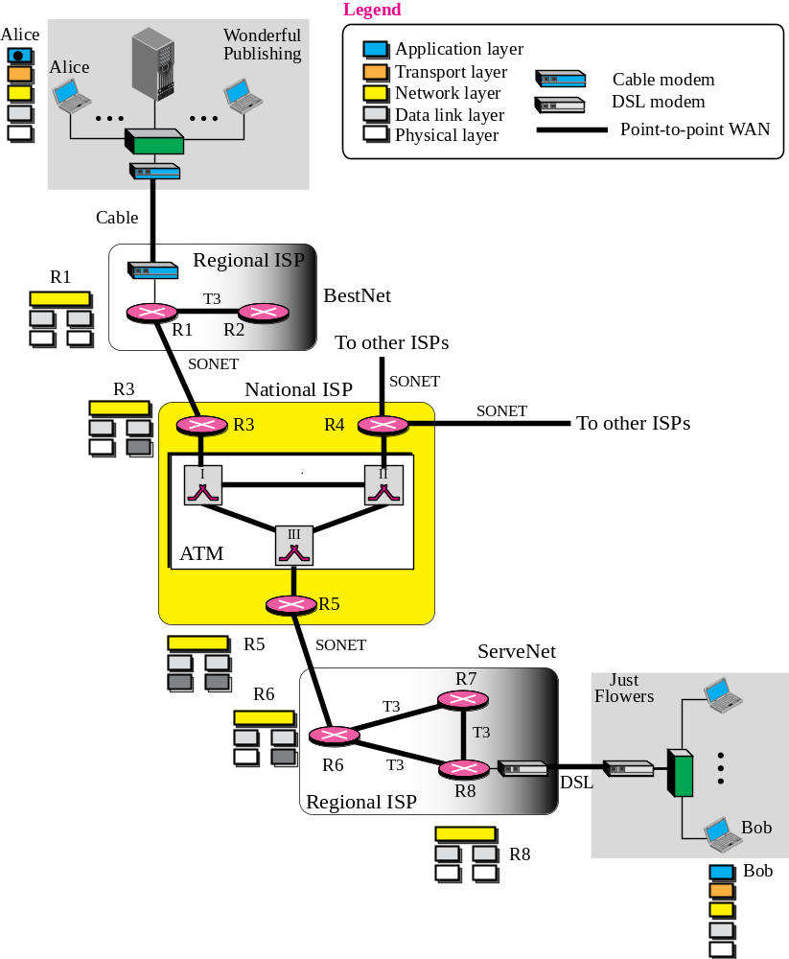
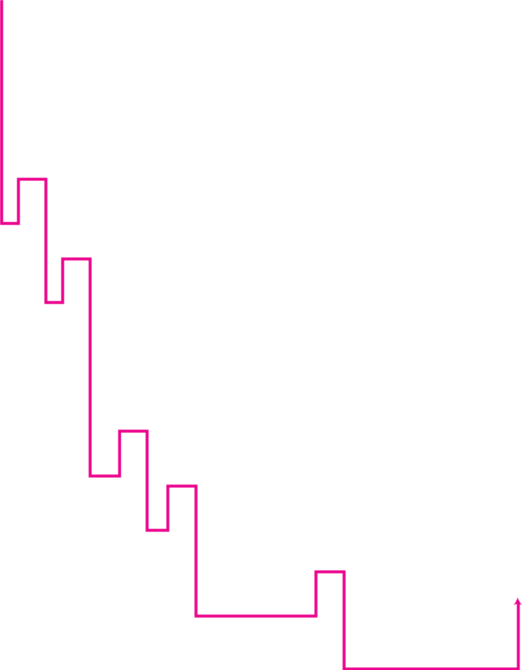
Logical Addressing
Figure 4.12 An imaginary part of the Internet

Slide 80
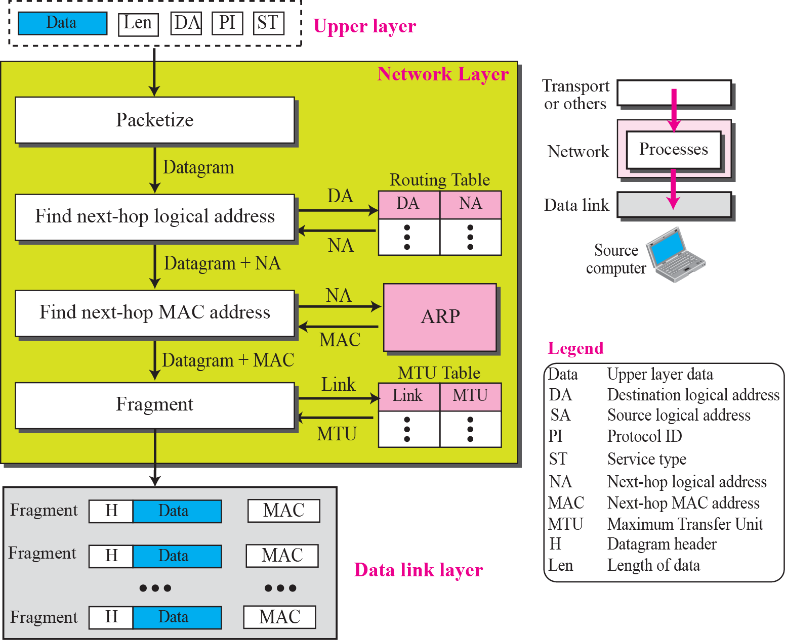
Services Provided at the Source Computer
Figure 4.13 Services provided at the source computer

Slide 81
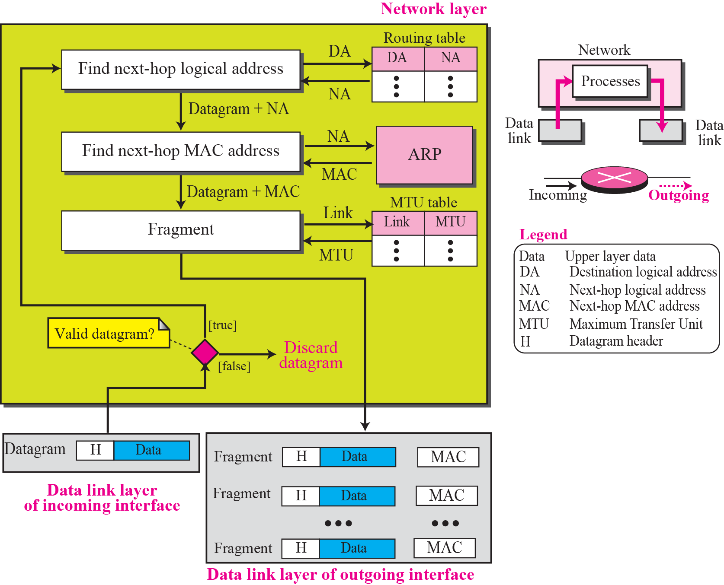
Services Provided at Each Router
Figure 4.14 Processing at each router

Slide 82
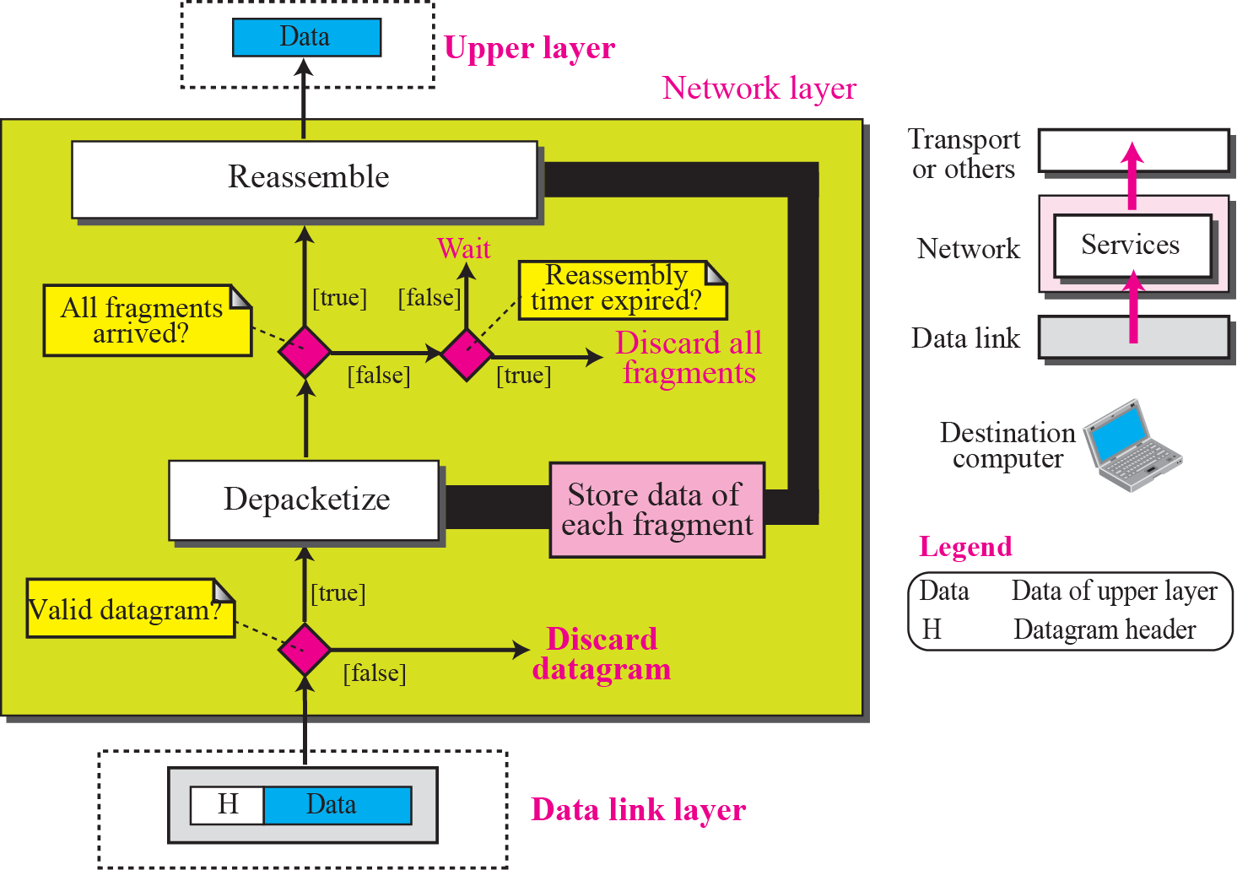
Services Provided at the Destination Computer
Figure 4.15 Processing at the destination computer

Slide 83
8.<number>
Notes:
1st =59+tfr
2nd =91.5+tfr
3rd=140
4th=81
5th =103.5
Order → 1,4,2,5,3

Slide 84
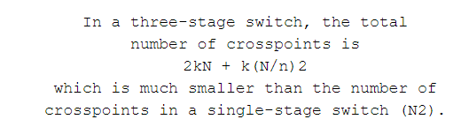
8.<number>

Slide 85
Problems
Design a three-stage, 200 × 200 switch (N = 200) with k = 4 and n = 20.
8.<number>

Slide 86
Problems
Design a three-stage, 200 × 200 switch (N = 200) with k = 4 and n = 20.
Sol. first stage we have N/n or 10 crossbars, each of size 20 × 4. In the second stage, we have
4 crossbars, each of size 10 × 10. In the third stage, we have 10 crossbars, each of size 4 × 20.
8.<number>

Slide 87
Sol conti.
The total number of crosspoints is 2kN + k(N/n)2, or 2000 crosspoints. This is 5 percent of the
number of crosspoints in a single-stage switch (200 × 200 = 40,000).
8.<number>

Slide 88
Drawback
one drawback—blocking during periods of heavy traffic.
Blocking refers to times when one input cannot be connected to an output.
8.<number>
Notes:
Blocking refers to times when one input cannot be connected to an output because there is no path available between
them—all the possible intermediate switches are occupied.
The whole idea of multistage switching is to share the crosspoints in
the middle-stage crossbars. Sharing can cause a lack of availability if the resources are
limited and all users want a connection at the same time

Slide 89
Non Blocking Condition
Clos investigated the condition of nonblocking in multistage switches.
In nonblocking switching fabric, the number of middle-stage switches must be at least 2n – 1.
In other words, we need to have k ≥ 2n – 1.
8.<number>

Slide 90

Clos Criteria
8.<number>

Slide 91
In Summary
What are the differences between a circuit switched network and a packet switched network?
Where can the control signals travel in a telephone network?
What is a non-blocking switch/network?
What are the differences between datagram packet switched and virtual circuit packet switched?
What are the differences between a circuit switch and a packet switch?

